Slide 1

Immersive Technology Development
Lesson 4:
Object Placement in AR
Elyas Chua-Aziz
cel9@np.edu.sg
Diploma in IM
October 2021

Slide 2
Object Placement in AR
Often times, we will want to give our users another layer of interactivity by placing objects in an AR space.
To do this, we will use a Vuforia feature known as Stages.
Stages in Vuforia allow our users to interact with physical spaces without the need for markers.
There are two kinds of stages, a Ground Plane Stage and a Mid Air Stage.
The Ground Plane Stage allows objects to be placed on ground that is detected by Vuforia.
The Mid Air Stage allows objects to be placed in the air, granted there are enough tracking features in the surrounding space for Vuforia to use.

Slide 3
Ground Plane Stage
The Ground Plane Stage provides our application with a virtual ground on which our objects can spawn.
This Stage will be superimposed on the physical ground that our AR Camera detects, and any objects spawned on it will be overlaid on the real ground.
This allows our users to tap on their screen to spawn AR objects.

Slide 4
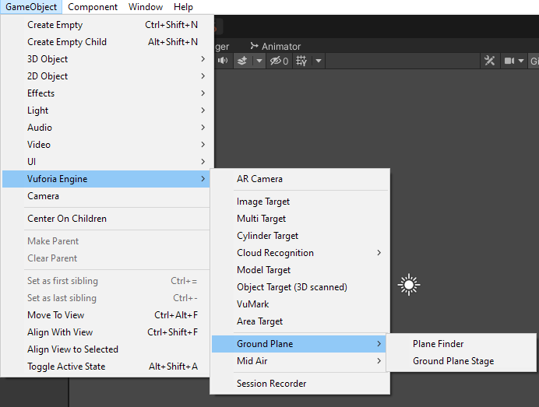
Ground Plane Stage
To get this feature in our project, we need to add two objects:
Ground Plane Stage
Plane Finder
These objects can be added from GameObject > Vuforia Engine > Ground Plane

Slide 5
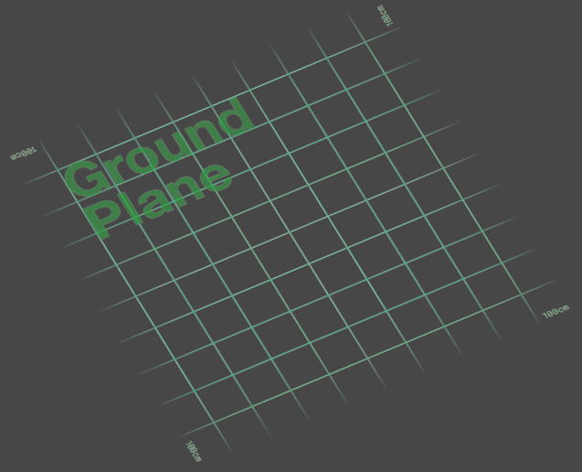
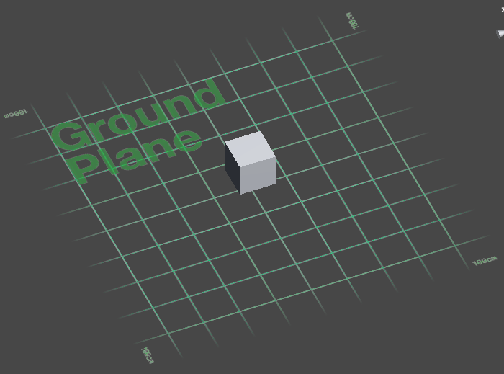
Ground Plane Stage
Once a Ground Plane Stage object has been created, you should see a plane with ‘100cm’ markings at its corners appear in your scene.
To define what should be spawned once our user taps on the screen, add the desired objects as children of the stage object.
Initial Ground Plane Stage
Ground Plane Stage with a cube child object

Slide 6

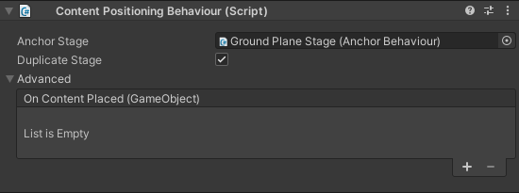
Plane Finder
With the stage object and its child object set up, we can work on the Plane Finder object.
Select the Plane Finder object in the Hierarchy, then drag and drop the Ground Plane Stage object into the Content Positioning Behaviour component.

Slide 7
Ground Plane Stage
Our project will now be ready to detect surfaces and use them as virtual ground for AR objects to be spawned on.
To test whether it works, connect your device to your development machine and choose the Build and Run option.

Slide 8
Demo Time!

Slide 9
Mid Air Stage
The Mid Air Stage provides our application with a trackable space where we can spawn floating objects.
Our AR Camera will look for trackable features in the environment and use those to place the Mid Air Stage.
Our users will then be able to tap on their screen and spawn objects on the Mid Air Stage.

Slide 10
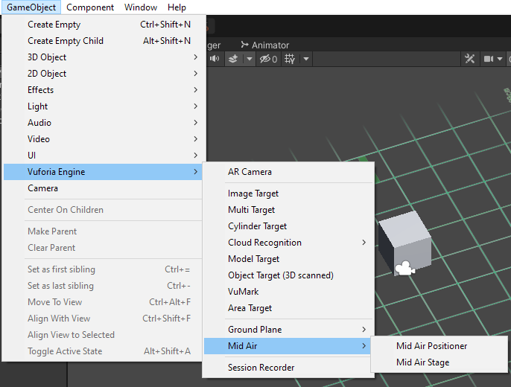
Mid Air Stage
To get this feature in our project, we need to add two objects:
Mid Air Stage
Mid Air Positioner
These objects can be added from GameObject > Vuforia Engine > Mid Air

Slide 11
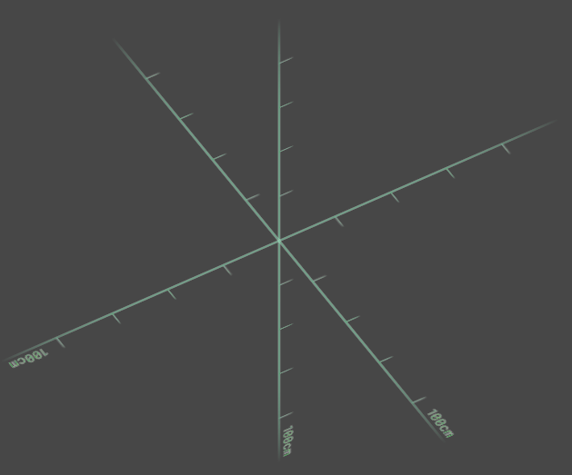
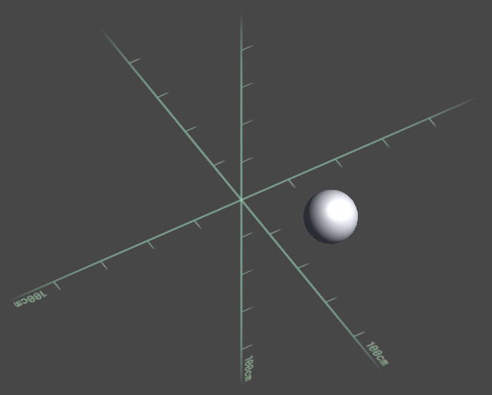
Mid Air Stage
Once a Mid Air Stage object has been created, you should see a 3d axis with ‘100cm’ markings at each axis appear in your scene.
To define what should be spawned once our user taps on the screen, add the desired objects as children of the stage object.
Initial Mid Air Stage
Mid Air Stage with a sphere child object

Slide 12

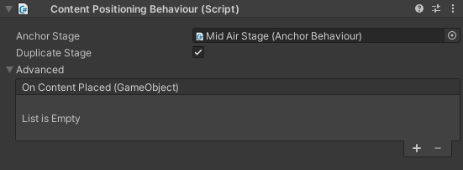
Mid Air Positioner
With the stage object and its child object set up, we can work on the Mid Air Positioner object.
Select the Mid Air Positioner object in the Hierarchy, then drag and drop the Mid Air Stage object into the Content Positioning Behaviour component.

Slide 13
Mid Air Stage
Our project will now be ready to detect trackable features in the environment and allow users to spawn floating objects when they tap the screen.
To test whether it works, connect your device to your development machine and choose the Build and Run option.

Slide 14
Demo Time!

Slide 15
Summary
By using Ground Plane and Mid Air Stages, we now have a simple implementation of marker-less AR by utilizing the surfaces and spaces in our environment as tracking targets instead.
Think about how you can, if it fits your concept, use these features with traditional marker based AR that can make your Assignment 1 application more immersive.

Slide 16
Your Turn! (CA1 Exercise)
From now till 2359 today, create a scene that:
Utilizes multiple different Ground Plane OR Mid Air Stages.
Using a UI Button, try cycling between the different stages to change what object is spawned when a tap is detected.
Hint: The active stage being used is in ContentPositioningBehaviour, which is part of the Vuforia API.
How can we change the active stage through code?
Join the Google Classroom, then zip and submit your project.
https://classroom.google.com/c/NDE4MzE1MzY4MDY1?cjc=y2uxexb
BONUS:
Have BOTH Ground Plane AND Mid Air Stages being cycled in ONE scene.

